Slide 1
WASTE MANAGEMENT AND RECYCLING ANALYSIS
SUBMITTED BY
Shehin

Slide 2
INTRODUCTION
Visualizes real-time patterns of waste generation by city and waste type to understand the scale and distribution of the problem.
Evaluates recycling efficiency and disposal methods to measure environmental impact and operational performance.
Enables strategic planning by highlighting yearly trends, performance gaps, and opportunities for sustainable improvement.

Slide 3
OBJECTIVE
To understand where waste is coming from and how much is being generated.
To check how well recycling and disposal methods are working.
To find better ways to improve waste management and protect the environment

Slide 4
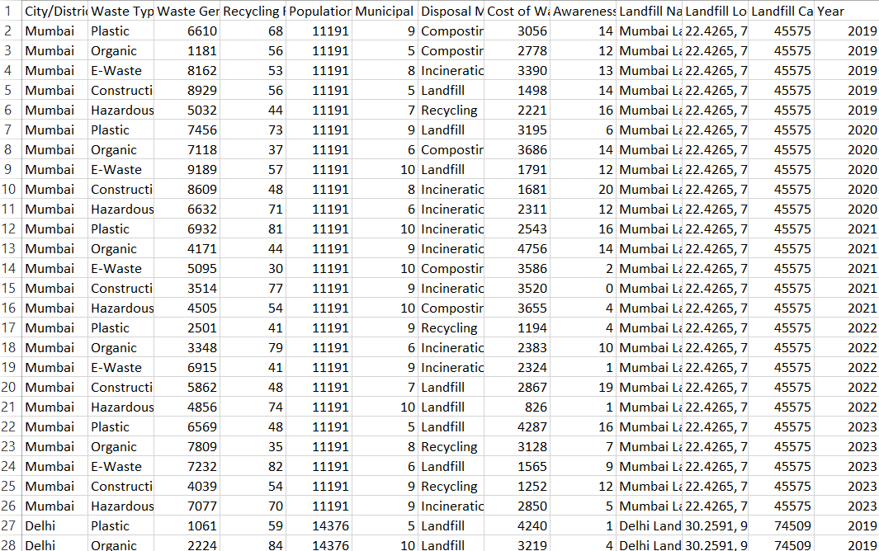
DATASET

Slide 5
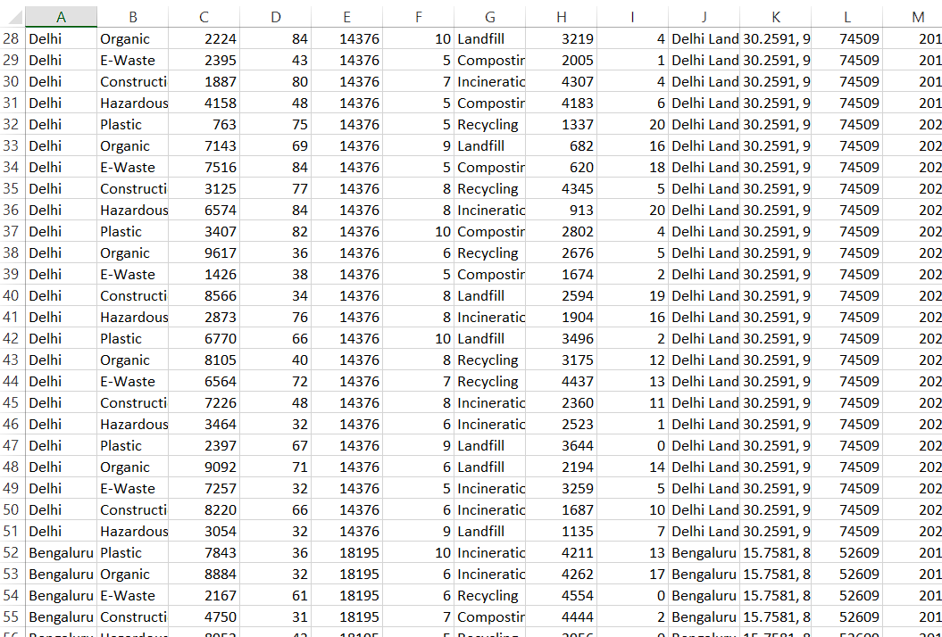
DATASET

Slide 6
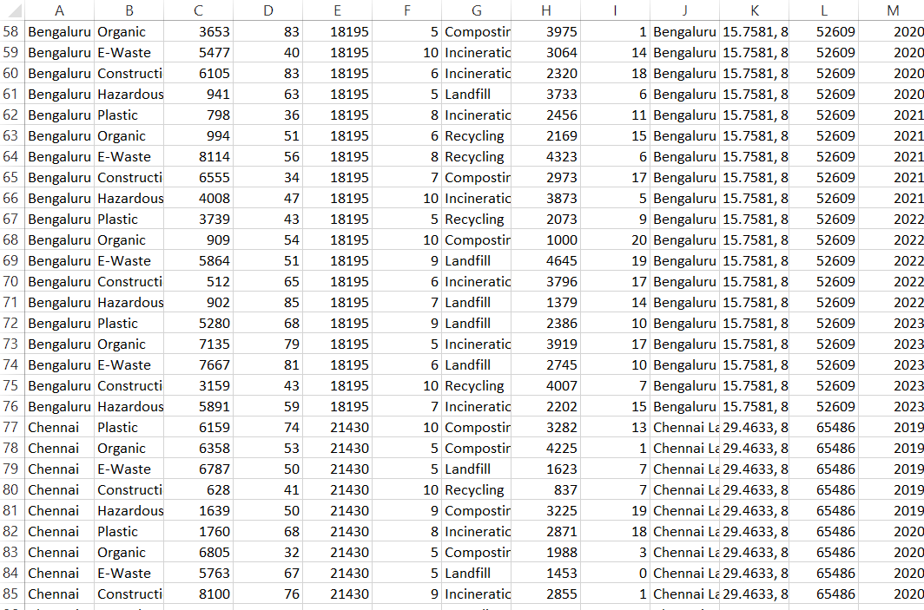
DATASET

Slide 7
CRITERIA USED
Tree Map : Waste Type Classification
Horizontal Bar Chart : Geographical Coverage (City-Level )
Dual Combination Chart : Time Period (Year-wise Analysis)
Bubble Chart : Recycling Rate Of Disposal Method
Pie Chart : Total Waste Generated Of Types Of Waste

Slide 8
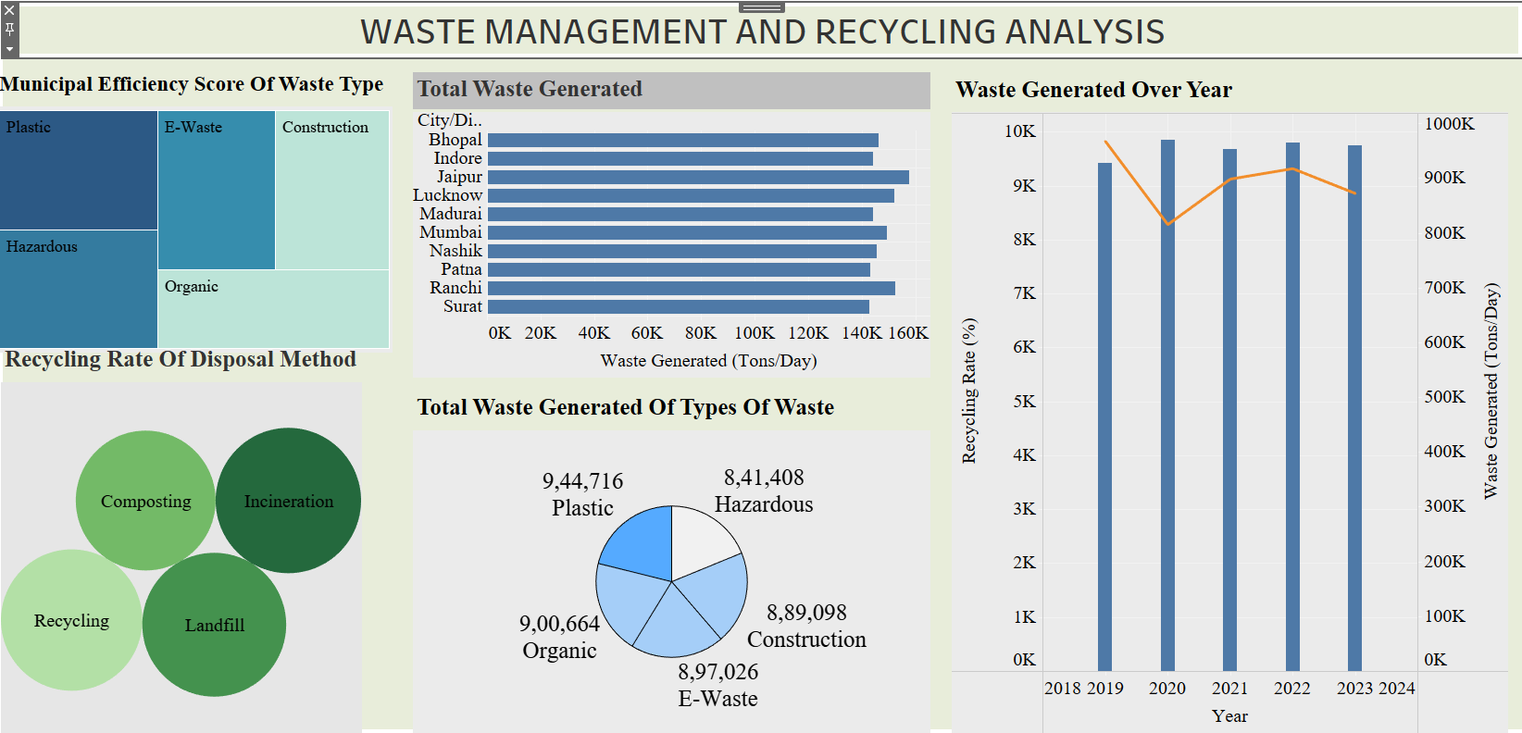
DASHBOARD

Slide 9
CONCLUSION
This dashboard clearly shows that waste generation is increasing every year, which makes efficient waste management more important than ever. While some cities are performing well, others still need improvement in recycling and proper disposal methods. The data also highlights that organic and plastic waste form a major portion of total waste, meaning better segregation and recycling can create a big impact. Overall, by improving municipal efficiency, promoting recycling and composting, and reducing landfill dependency, we can move towards a cleaner, healthier, and more sustainable future.

Slide 10
THANK YOU

